Slide 1

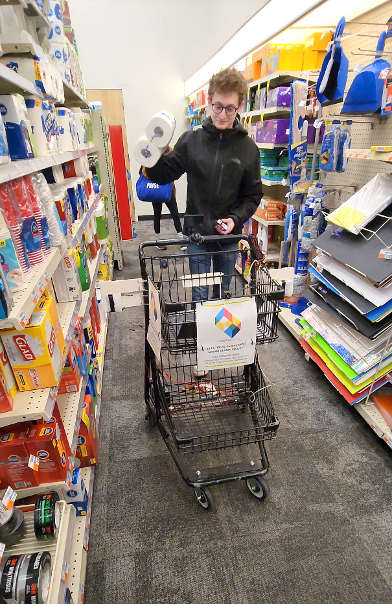
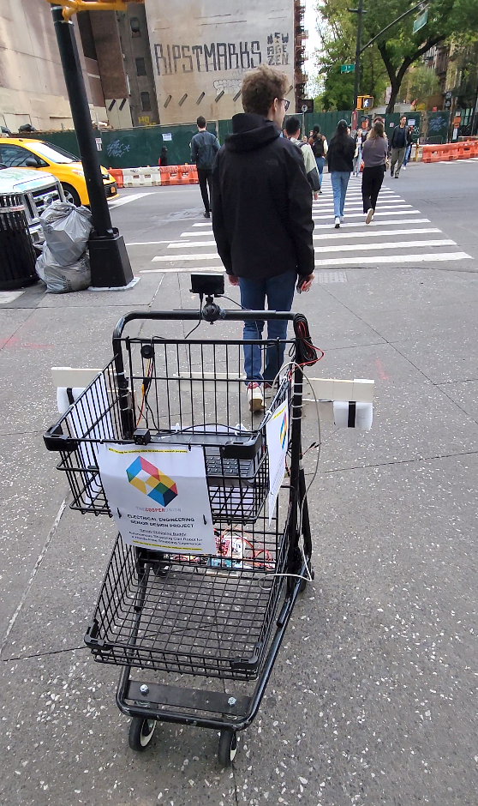
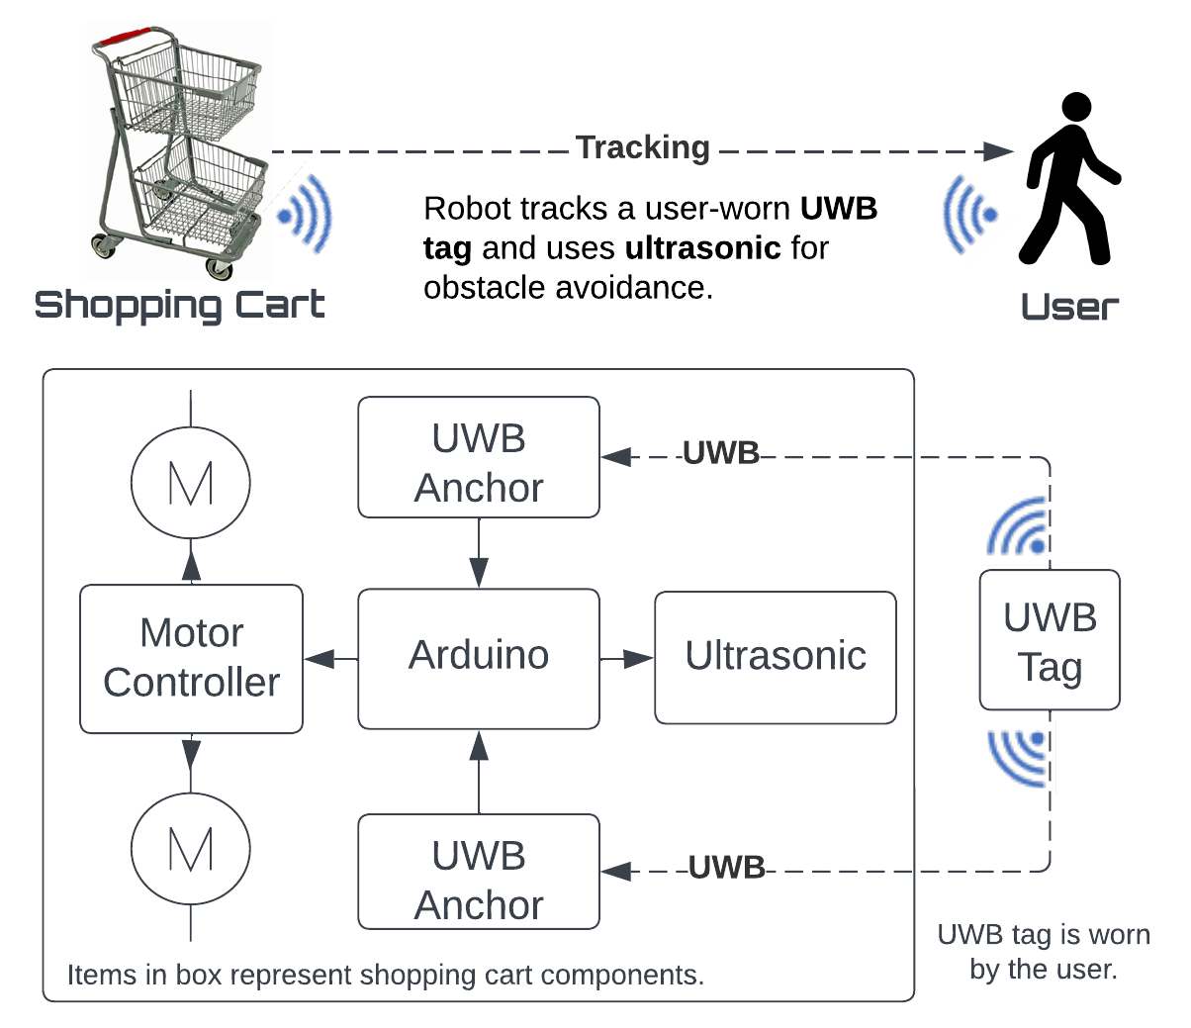
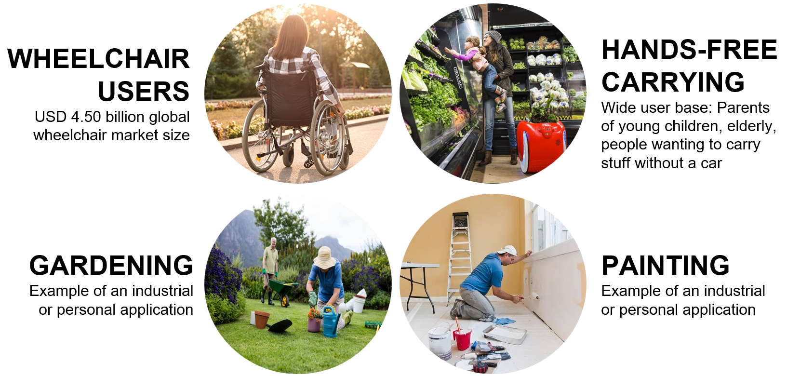
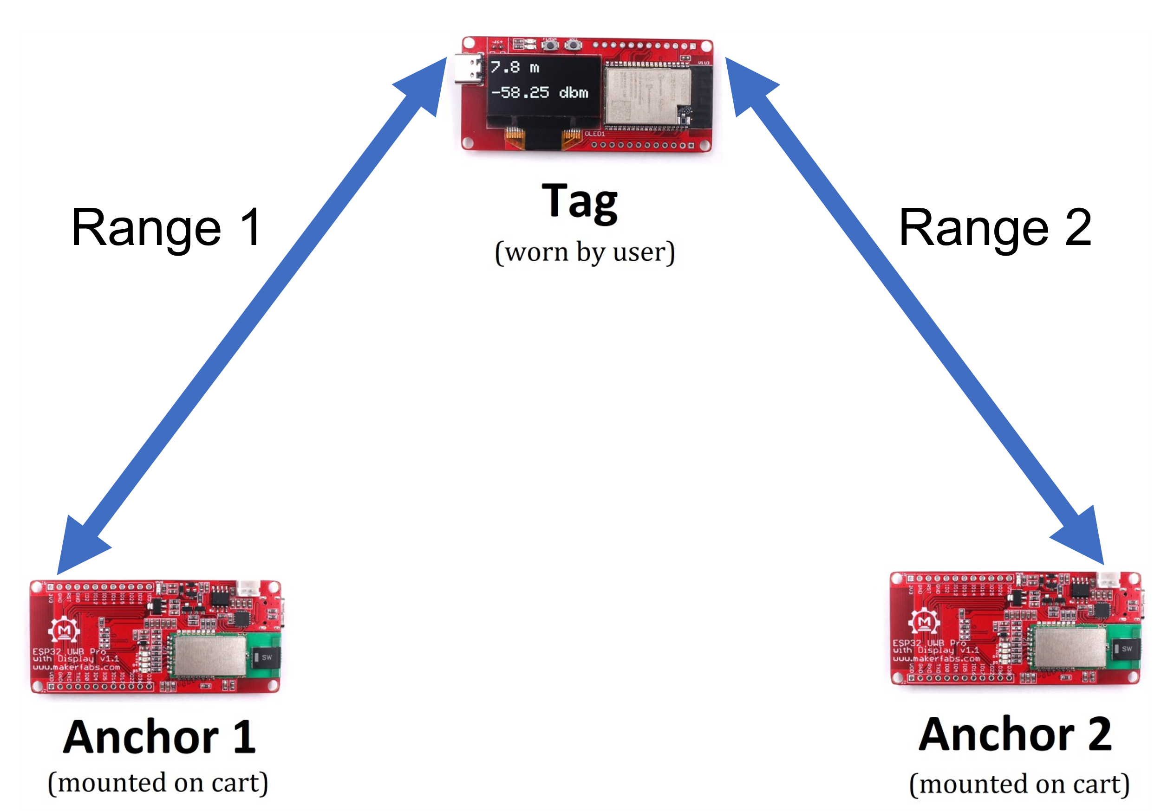
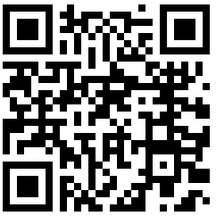
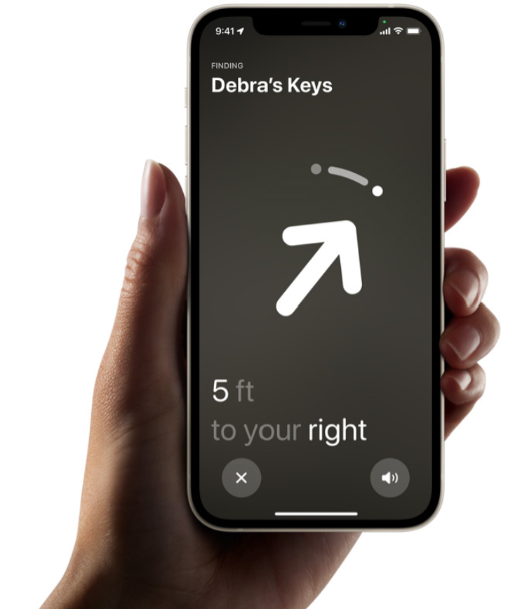
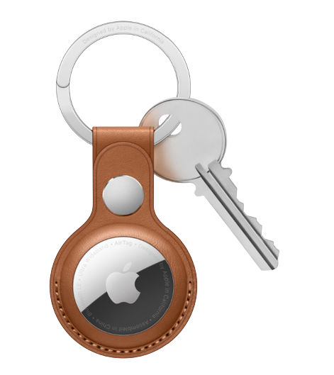
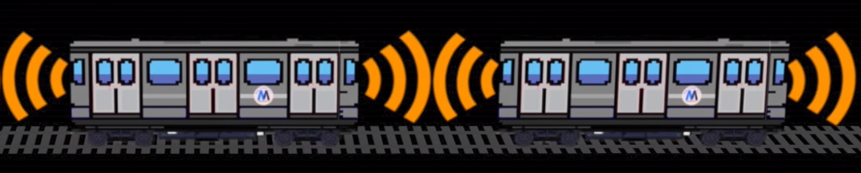
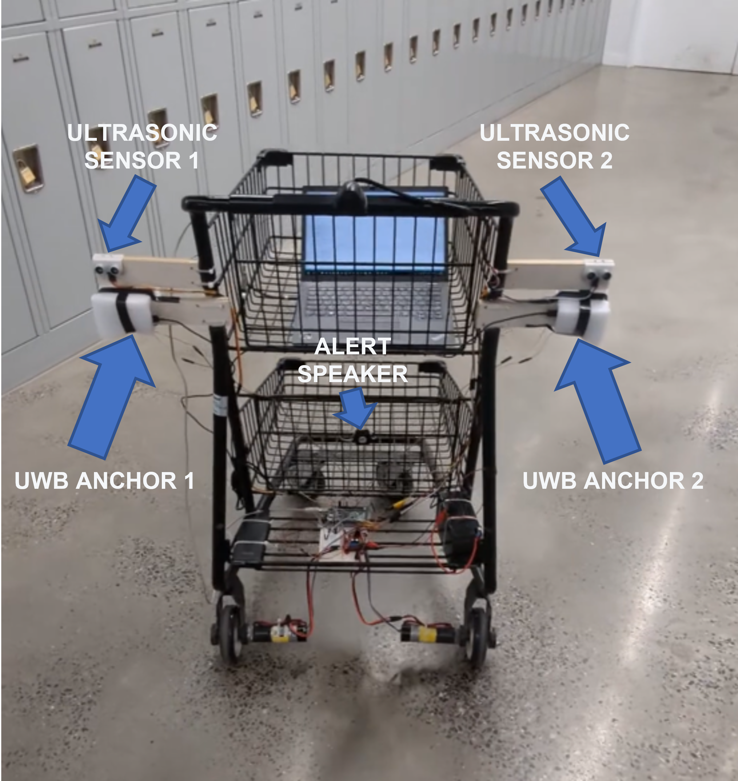
Smart Shopping Buddy
Autonomous Shopping Cart Robot for a Hands-Free Shopping Experience
EE Capstone Senior Design
May 2, 2023
Team: Gregory Presser, David Guo, Eric Xu | EE 2023
Advisors: Professor Neveen Shlayan, Professor Carl Sable
Problem Statement
The Shopping Cart
Real World Test
Create an autonomous shopping cart robot that follows the user and avoids obstacles to enable people to live more of their lives hands-free.
Utilize groundbreaking UWB technology for tracking and Ultrasonic sensors for obstacle avoidance to provide a superior tracking experience.
Sensor Architecture:
Example Use Cases
What is Ultra-Wideband (UWB)?
UWB is a short-range wireless communication technology that enables both locational and directional accuracy to a few centimeters!
Tracking algorithm triangulates the location of the user relative to the cart with three UWB sensors:
Scan the QR code to see the cart in action!
Video Link: https://youtu.be/4n23PwxU1b8
Examples of Ultra-Wideband Applications:
Reflections
Apple AirTag: Precise tracking
During our test in public spaces, people responded with curiosity and interest.
Many people commented or asked questions about the shopping cart.
While future work includes implementing a more robust obstacle avoidance system, this project demonstrates the benefit this type of product can bring to people’s lives.
MTA:
CBTC (Communication-Based-Train-Control)
UWB is different from other wireless data transfers:
Uses a pulse pattern in the time domain whereas conventional wireless transmissions vary a sinewave's amplitude, frequency, or phase.
Pulse-based transfer allows Time-of-Flight calculation to measure distance btw. Tx and Rx.
Acknowledgments
Cart Fabrication: Brian Yudin, Sinisa Janjusevic
Motor & Battery Spec: Jon Lu, Dan Mezhiborsky

